Slide 1
Counting Employees
IRP Data Reporting Brown Bag Meeting
February 24, 2017
February 27, 2019

Slide 2





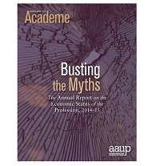

Why we count: external obligations
Federal Government
Accreditation
Rankings
Publications
Data Exchanges

Slide 3

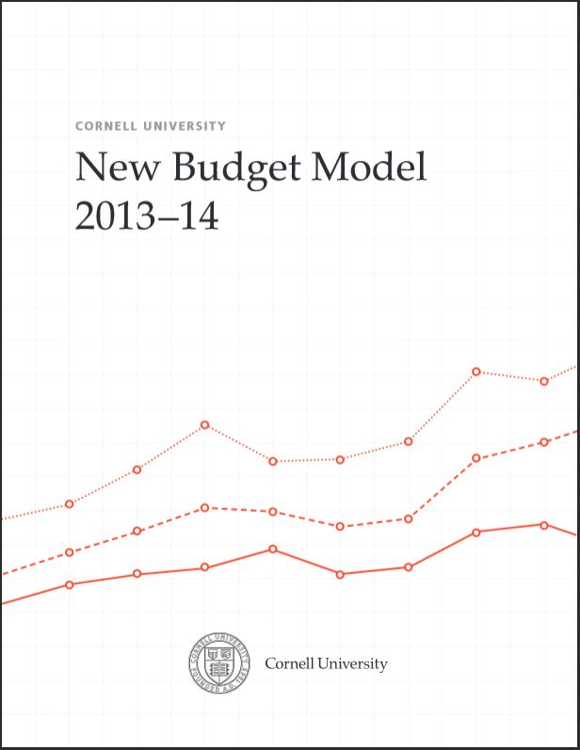
Why we count: internal purposes
Budget Model
Salary Analysis
Strategic Metrics
University Factbook (public)
Academic Program Review
Myriad ad hoc analyses

Slide 4
Nonacademic Staff
Academic Employees
Faculty
Academic Professionals
Employees
Staff

Slide 5
Creation of a Longitudinal Dataset
Sources 2001-2012
Pre Workday extracts (2001-to 2012)
APDB : Academic Personnel Database Nov 1
  Data of record for faculty and academic professionals
Merge with:
PeopleSoft for non academics Oct 31
  PAIDS Report (Position and Incumbent Dataset)
  Data of record for staff

Slide 6
Sources 2013 to 2018
Workday
AIS: Academic Information System (AIS Dataset) Nov 1
Append to:
PAIDS Report (Position and Incumbent Dataset) Nov 1

Slide 7
How we counted
Snapshot
  Everyone was counted only once (headcounts)
Leave was treated differently
  Academics on leave are included
  Staff on leave are excluded

Slide 8
People doing multiple things
Hierarchy of job families
  Faculty first then Academic Professional then Staff
Primary appointments
  Joint appointments: use IRP defined ‘primary’
  Executives: counted as faculty in their academic department homes

Slide 9
Changes - Why
  Other populations requested

Slide 10
Nonacademic Staff
Academic Employees
Faculty
Academic Professionals
Employees
Other Academics (short term)
Staff
Temps
Student Employees
Staff on Leave
Undergrad
Grad
PostDocs
Acad Admin

Slide 11
Changes - Why
  difficulty in following old methodology; not sustainable and a lot of work
  Re-thinking around oracle models in an IRP datamart.

Slide 12
Changes - Methodology
Nov 1 2018…
Combine old APDB extracts, PeopleSoft PAIDS reports, Workday AIS dataset and Workday PAIDS reports and keep all jobs (Primary and secondary, all populations*). PAIDS is now data of record, all years.
Logic for “primary” job, when there are multiple
  Professorial
  Acad Professional (if paid)
  Acad Administrator (if paid)
  Staff & Union (if paid)
  PostDocs
  Academic Other (short-term) (if paid)
  Students (if paid)
  Temps (if paid)

Slide 13
Changes - Methodology
Nov 1 2018…
  Summarized FTE, summarized work hrs/week calculated to determine part time/full time
  Additional files created or merged in:
    Labor Distribution (% paid by fund group)
    Current Organizational Schema
    Current Job Code Attributes
    Degrees for Academics (2017 on)
    Leave Types (2013 on)

Slide 14
Changes - Methodology
Feb 2019 Factbook updated…
Implications:
Historical data changed in some situations:
More robust research file with many more populations and includes more than just ‘primary’ jobs. More easily updatable and understandable.
Nov 2012 | Faculty | Acad Prof | Staff | Total
Old | 1587 | 1076 | 7004 | 9667
New | 1584 | 1073 | 7006 | 9663

Slide 15
Staff
Everyone who isn’t listed to the right, but
Academic Professional
Research titles
Instructor, lecturer titles
Academic short term
Post docs
Extension titles
Visiting instructional
Visiting critics
Faculty
Professorial titles only
Includes professor +:
Includes part-time, on leave
Librarian titles
clinical
“of practice”, research
acting
Adjuncts
Temps
County extension
Lay off
On leave
Students
Does not include:
Temp staff: includes residents & interns
Notes:
Acting titles are now Academic Short Term

Slide 16
Links
CURRENT FACTBOOK:
  http://irp.dpb.cornell.edu/university-factbook/employees
ARCHIVE ACADEMICS: http://cornellirp.wpengine.com/tableau_visual/factbook-academics
ARCHIVE NON-ACADEMICS:
  http://cornellirp.wpengine.com/tableau_visual/factbook-nonacademic-staff
Contacts
  Deb Fyler djf5
  Luga Simmonds lrs96
  William Searle wrs77

