Slide 1
IRP Brown Bag Facts at Your Fingertips
Marin Clarkberg, Associate Vice Provost
Institutional Research & Planning

Slide 2
Data Reporting… Special Interest Group?
Familiarize others with what we do in Institutional Research & Planning (IRP)
Identify ways in which we can help you
Explain ourselves and our practices to you
Provide a forum for discussing issues and best practices for handling reporting institutional data
Let’s discuss before we leave!

Slide 3
Today’s Goals
Introduction to IRP staff
Review the mission & function of IRP
Review tools for reporting data to external audiences
Leave time for questions, discussion, brainstorming

Slide 4
IRP Mission
irp.dpb.cornell.edu/about-us
The mission of Institutional Research and Planning is to provide official, accurate, and unbiased information and analysis about the university in support of institutional planning, decision-making, and reporting obligations.

Slide 5
IRP Mission
irp.dpb.cornell.edu/about-us
The mission of Institutional Research and Planning is to provide official, accurate, and unbiased information and analysis about the university in support of institutional planning, decision-making, and reporting obligations.

Slide 6
IRP Mission
Serves as an information clearinghouse for the university,
producing publicly accessible statistical summaries of the university, including the online Factbook
providing data about the university to governmental agencies
responding to external requests for information (e.g. from college guide publishers)
coordinating the university’s participation in a variety of consortial data exchanges

Slide 7
IRP Mission
Organizes, administers, and reports on population surveys of university constituencies (e.g. graduating seniors)
Engages in in-depth research projects and report writing on topics of special concern to the Provost and other university leaders
Supports efforts related to programmatic and institutional assessment, including university accreditation and the registration of academic programs with New York State
Uses institutional data to inform the undergraduate admissions process
Advocates for the quality and integrity of university data

Slide 8
Defining data elements
We have been compiling data about the university with consistent, persisting definitions for decades
Many of our practices with respect to defining data elements are given to us externally
US Department of Education (IPEDS)
Common Data Set

Slide 9
Factbook

Slide 10
Common Data Set (CDS)

Slide 11
Common Data Set (CDS)
Provides answers to many frequently asked questions
Enhances the comparability of data reported across institutions with a standardized questionnaire with detailed definitions and directions
Developed through collaboration among colleges and universities, college guide publishers, the National Center for Education Statistics, and others.
Notes:
The stated goal is to provide accurate and timely data to the public while decreasing the burden on university staff.

Slide 12
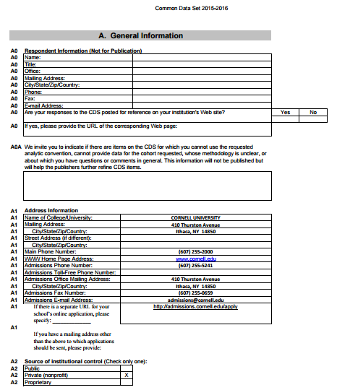
Common Data Set

Slide 13
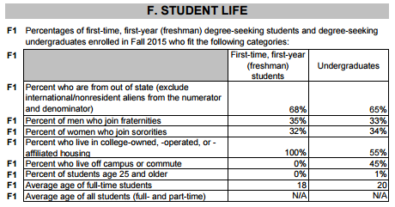
Common Data Set

Slide 14
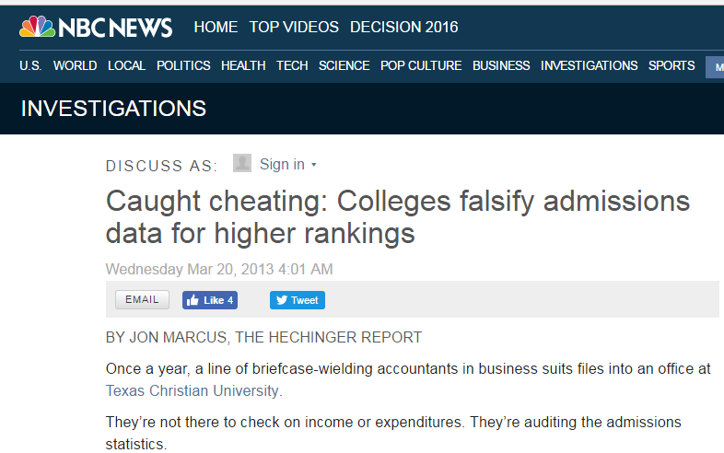
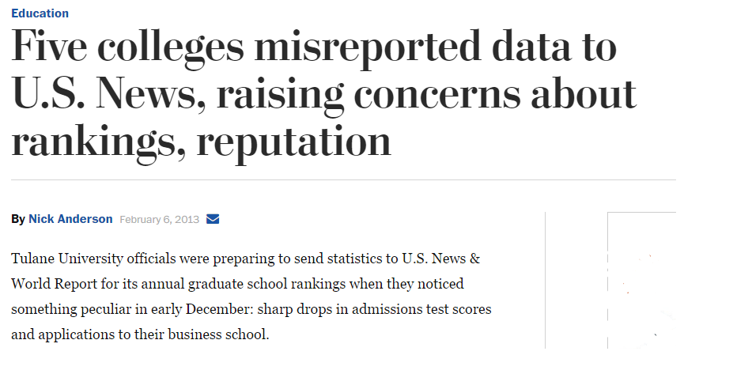
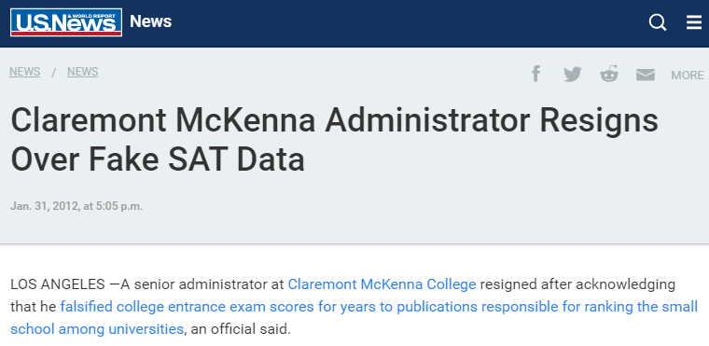
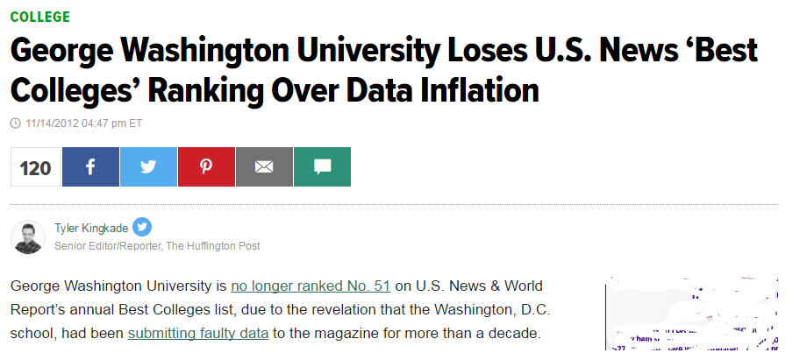
External data requests and institutional integrity

Slide 15
External data requests: When does IRP handle them?
Serves as an information clearinghouse for the university,
producing publicly accessible statistical summaries of the university, including the online Factbook
providing data about the university to governmental agencies
responding to external requests for information (e.g. from college guide publishers)

Slide 16
External data requests: When does IRP handle them?
External requests that:
Seek to characterize the institution as a whole
Are framed around information contained in institutional data systems to which IRP has direct access (e.g. student records, personnel records)
Focus on topics that relate specifically to Cornell’s educational mission (e.g. admission rates, graduation rates, student-faculty ratios)
IRP does not manage external requests for data that:
Pertain only to specific units within the institution (e.g. the college of Engineering, or the field of Economics)
Rely predominantly on sources of data to which IRP does not have access (e.g. facilities, research expenditures)
Focus on topics that are primarily non-academic (e.g. finances, student life)

Slide 17
External data requests: When does IRP handle them?
IRP can sometimes serve as a resource for other units who are responding to external requests for data.
For example, a specific professional program might need to provide student headcounts or admissions information to a specialized accrediting agency.
While IRP does not take on primary responsibility for managing that sort of program-specific information inquiry, IRP will collaborate with responsible entities in the units to provide requested information where possible.

Slide 18
Questions, Discussion

Slide 19
Future topics?
All about: someone else
Faculty data
Budget model data
Rankings
Surveys (e.g. students, employees)
All things Tableau
Academic programs

