Slide 1
Tableau Upgrade – Combined Instance
IRP Data Reporting Brown Bag Meeting
January 6, 2017

Slide 2
Background
Two separate implementations
A&S/AA&D/HumEc and IRP/DBP
Overlapping users
Different authentication schemes
Different Tableau versions

Slide 3
Consolidated, centrally administered Tableau
One implementation
Same authentication for all users
Existing IRP/DBP users and all Publishers will see a different log in screen
Tableau version 10.1.3
  A&S/AA&D/HumEc now on v8.2.17
  IRP/UBO now on v10.0.1

Slide 4
Consolidated, centrally administered Tableau
Prod and Test (soon) environments
Part of CIT ODAA infrastructure
  Monitoring and on-call support
Tableau user support is unchanged
  Contact your existing support folks

Slide 5
What the new instance means to you
User Authentication
Existing Report Links
Changes in the New Version
Tableau Desktop Upgrade

Slide 6
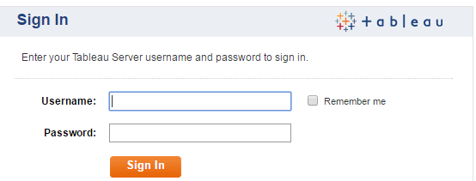
User Authentication – What you’re used to
A&S/AA&D/HumEc or ‘KPI’ instance.
Use a link that routes you to a CUWebAuth login web page for authentication. (aka “Black Box”); CU netid and password
Also, you may have had a ‘local’ id on the tableau.kpi.cornell.edu server; CU NetID and ‘local’ password

Slide 7
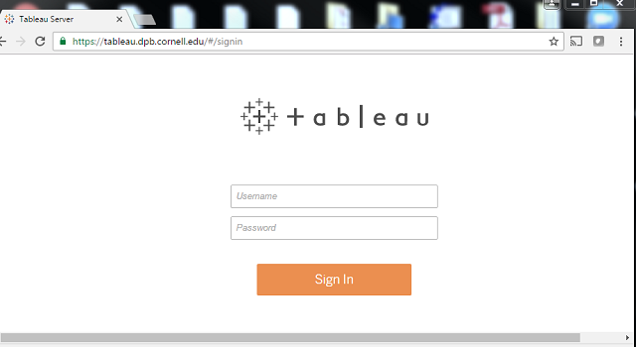
User Authentication – What you’re used to
IRP/DBP instance.
Uses Active Directory authentication
Use your Cornell NetID and password

Slide 8
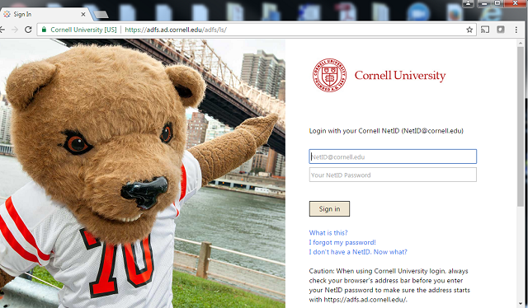
User Authentication – New combined Tableau
Integrated with Cornell Active Directory Federated Services (ADFS).
Complies with ITSO standards for CU web service authentication
Use your Cornell NetID and password

Slide 9
Existing Report Links
The new URL is https://tableau.cornell.edu
Existing links to the KPI server will work (redirect in web server)
No need to reformat URL’s into “Black Box” format for sharing
Existing “Black Box” links will continue to work with the new instance.
    However, we recommend switching to the new native URL soon
      Timeframe TBD
    Provides transition time to edit web pages with new URL and for users to change report bookmarks

Slide 10
Existing Report Links
The new URL is https://tableau.cornell.edu
Existing links to the IRP instance will work (redirect in web server).
    However, we recommend switching to the new native URL soon
      Timeframe TBD
    Provides transition time to edit web pages with new URL and for users to change report bookmarks

Slide 11
Tableau differences 8.2 to 10.1
Ability to JOIN data from different data sources
Use Filters across different data sources
Redesigned User Interface – faster response
New/Redesigned ‘Action’ buttons
- Subscribe – new look
- Share –Allows you to create a link to a View and email it
- Download – Workbook, Image, Data, PDF, Cross Tab (combined from ‘Export’ icon)
- Full Screen – View in Full Screen Mode

Slide 12
Performance improvements
• Tableau 10.1 is 3 to 4 times faster than 8.2
• Multicore Query Execution
• Persisted Query Cache
• Parallel Queries

Slide 13
Product Information and Features
For other detailed information on release 10.1
see http://www.tableau.com

Slide 14
Tableau Desktop Upgrade
For Publishers only
Recommend upgrade to 10.1.3
Use normal channels to obtain installer

Slide 15
Questions?

